Slide 1

Notes:
Intervening is about having courage.
Courage to do the right thing. Courage to do all you can to protect our business, communities and colleagues. Courage that demonstrates care for yourself, and those who mean the most to you.
We're finishing 2021 strong by committing together to listen and speak up about what intervening means to us all in Team Wood.

Slide 2
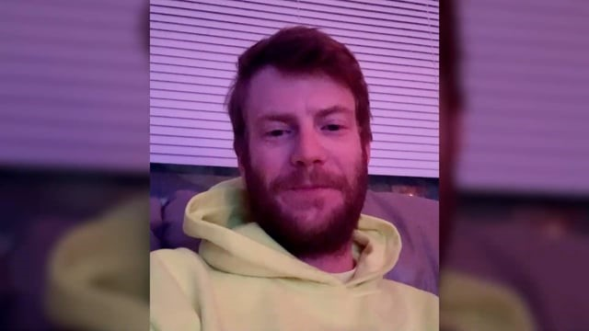
We intervene for health
Click on the video to hear from our colleague Adam Davis, quality control inspector on a large infrastructure project out of Michigan, US.
Adam’s job revolves around intervening to ensure work is safe but speaking up is something that has been instilled in him all his life. Learn about how Adam spoke up to protect his family and his colleagues when COVID cases were discovered on site.
Notes:
Watch the video:
https://vimeo.com/647322184/3dfe2dfedc
Use the below as talking points:
What inspires you about Adam’s intervention?
Think about and share examples of when you have intervened for security. Why did you intervene? What courage did it take? What could the consequences have been had you not taken that action?
The below are suggested actions having heard this moment:
Take this moment and share it onwards within your own communities and connections in Wood.
Share your own We intervene story on our All Company Global Wood Yammer group using the hashtag #Weintervene, to inspire others.
Do you know an inspiring colleague who has intervened? Nominate them in our Shield Awards: https://woodplc.sharepoint.com/hssea/pages/shield-awards.aspx
Keep updated on coronavirus guidance at Wood here: https://woodplc.sharepoint.com/coronavirus/Pages/default.aspx
Record your safety intervention on our HEART system here: https://cfapps.amecfw.com/HEART/index.cfm
Explore Intervention Skills training through the HSSES A-Z Knowledge Bank here: https://woodplc.sharepoint.com/HSSEA/Pages/knowledge-bank.aspx

